Slide 1

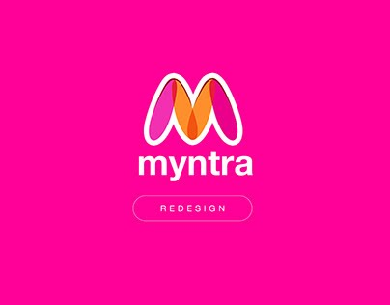
FINAL PRESENTATION ON MYNTRA
ATHARVA PRAMOD NIMBALWAR (002625645)
KARAN SRINIVAS (002474804)
MOINUDDIN MOHAMMED (002275124)
UTTKARSH BHARADIA (002872928)

Slide 2




OVERVIEW
Redesigning Myntra's platform to optimize usability and elevate user satisfaction by refining browsing, searching, and purchasing experiences.
Employing design thinking methodologies and persona development to understand and address user needs, ensuring prioritization of features aligned with user preferences.
Crafting a comprehensive design system and implementing responsive design principles to ensure consistency and accessibility across various devices.
Delivering an intuitive and visually appealing platform, aiming to amplify user engagement and drive increased conversion rates through enhanced usability.

Slide 3

INTRODUCTION TO MYNTRA
About: Redesigning Myntra's digital shopping platform to enhance user experience and satisfaction, addressing usability issues and improving navigation for a seamless shopping journey.
Project Type: An academic endeavor aimed at applying theoretical knowledge in UX design, utilizing Figma for prototyping and iteration to gain practical experience in interface design.
Tools Used: Leveraging Figma as the primary collaborative interface design tool for prototyping, enabling real-time collaboration and seamless iteration among team members.
Duration: Spanning a Month, the project involved comprehensive stages from research to designing prototype, allowing thorough exploration of user needs and iterative design refinement.
Responsibilities: Conducting qualitative and quantitative user research, creating personas to guide design decisions, crafting wireframes and prototypes in Figma, iteratively refining designs, and collaborating with team members to ensure alignment with project objectives.

Slide 4
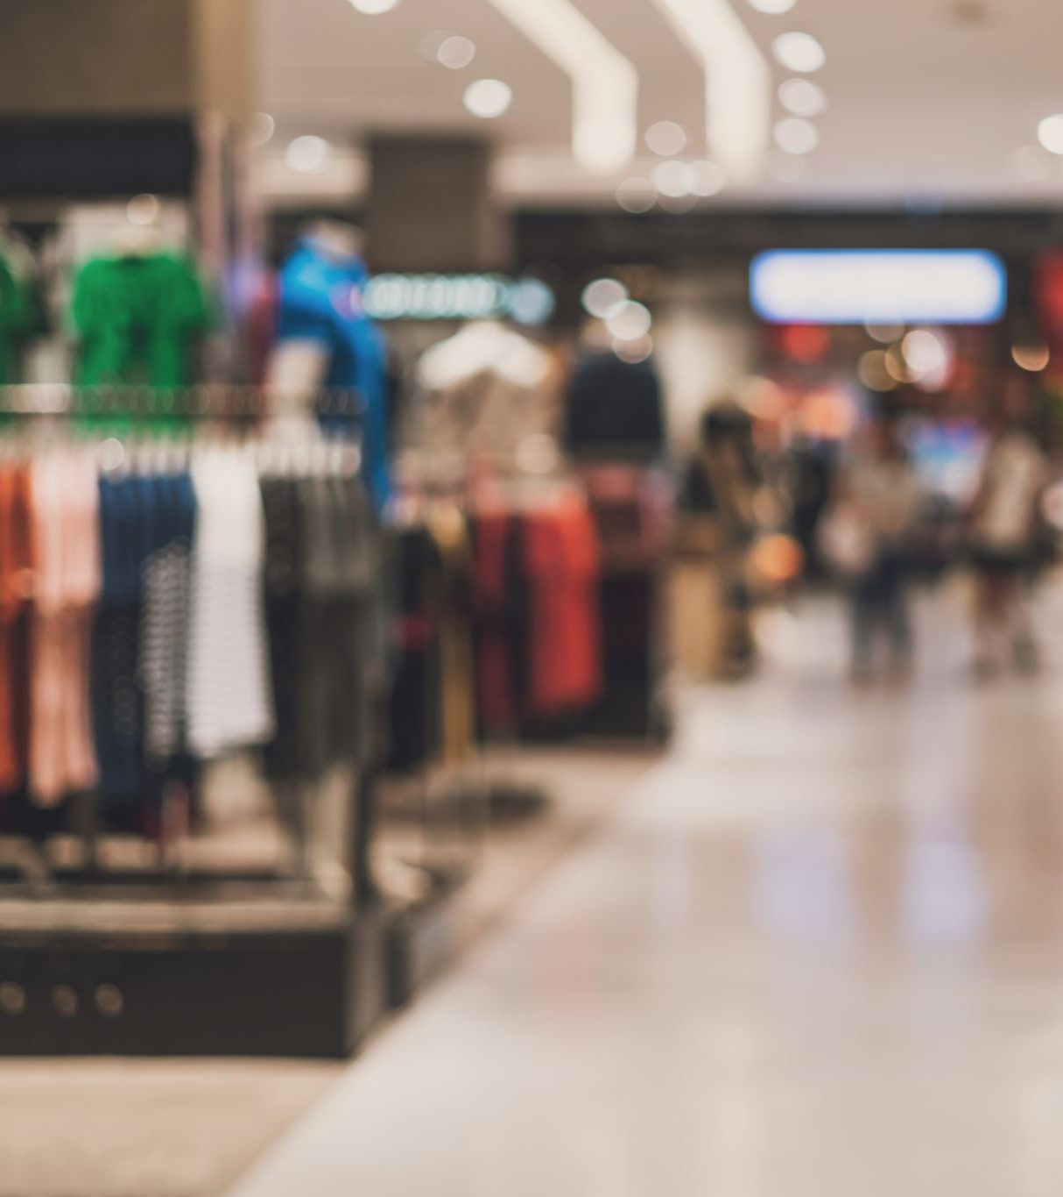
PROBLEM STATEMENT & SOLUTION
Problem Statement:
Myntra's current digital shopping platform faces usability challenges, including complex navigation and limited personalization options, leading to user frustration and decreased engagement.
Solution:
Redesigning Myntra's platform to streamline navigation, enhance personalization features, and optimize the overall shopping experience, ultimately improving user satisfaction and increasing engagement.

Slide 5
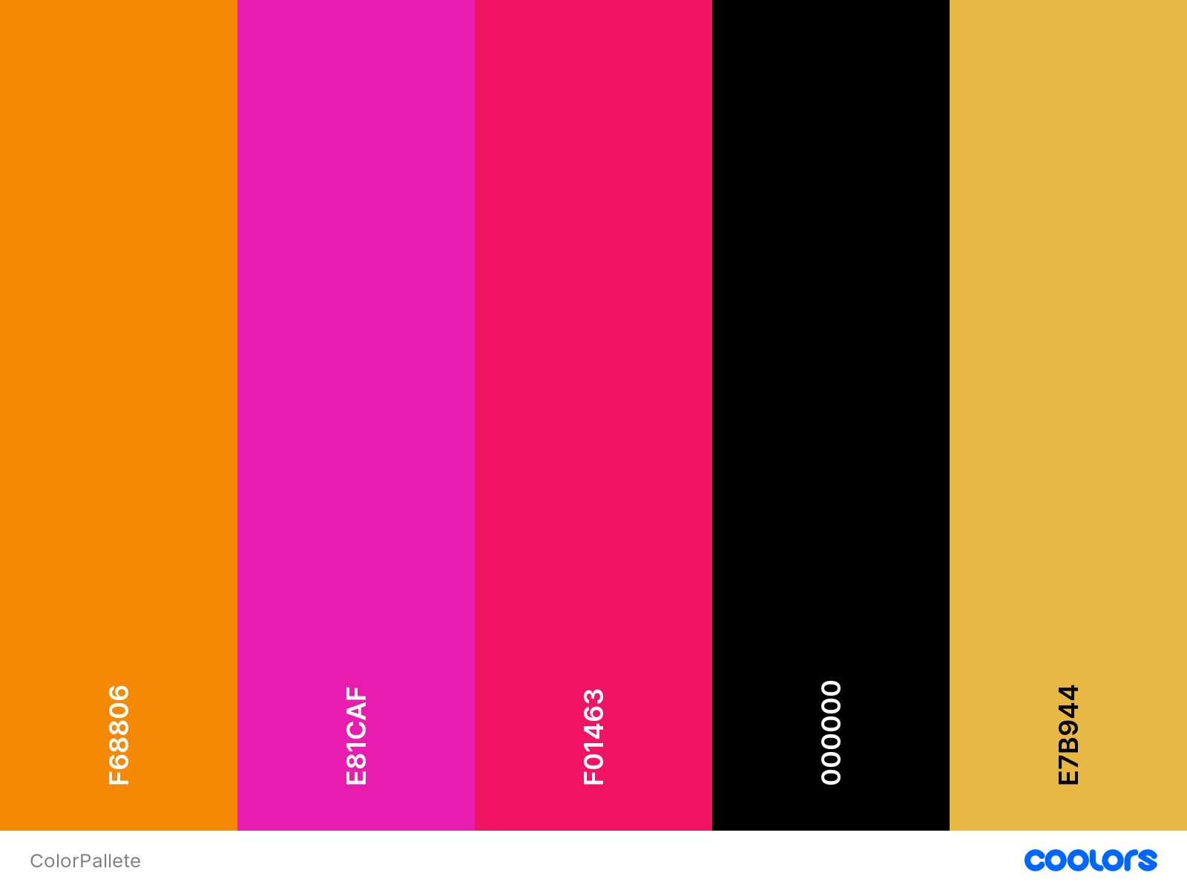





DESIGN SYSTEM
Colors: Utilizing a vibrant color palette comprising of Myntra's brand colors to evoke a sense of energy and excitement, while ensuring accessibility and visual hierarchy.
Typography: Implementing a modern and legible typeface for clear communication, with variations in font weights and sizes to enhance readability and hierarchy.
Icons: Incorporating a set of custom-designed icons consistent with Myntra's brand identity, enhancing visual communication and aiding in intuitive navigation.
Font Style
Inter & Istok Web
Dimensions & Layout: Adhering to responsive design principles to ensure scalability across devices, with consistent spacing, grid systems, and breakpoints for seamless user experience.
Logo: Retaining Myntra's iconic logo, ensuring its prominence within the interface while maintaining consistency with the overall design system.

Slide 6
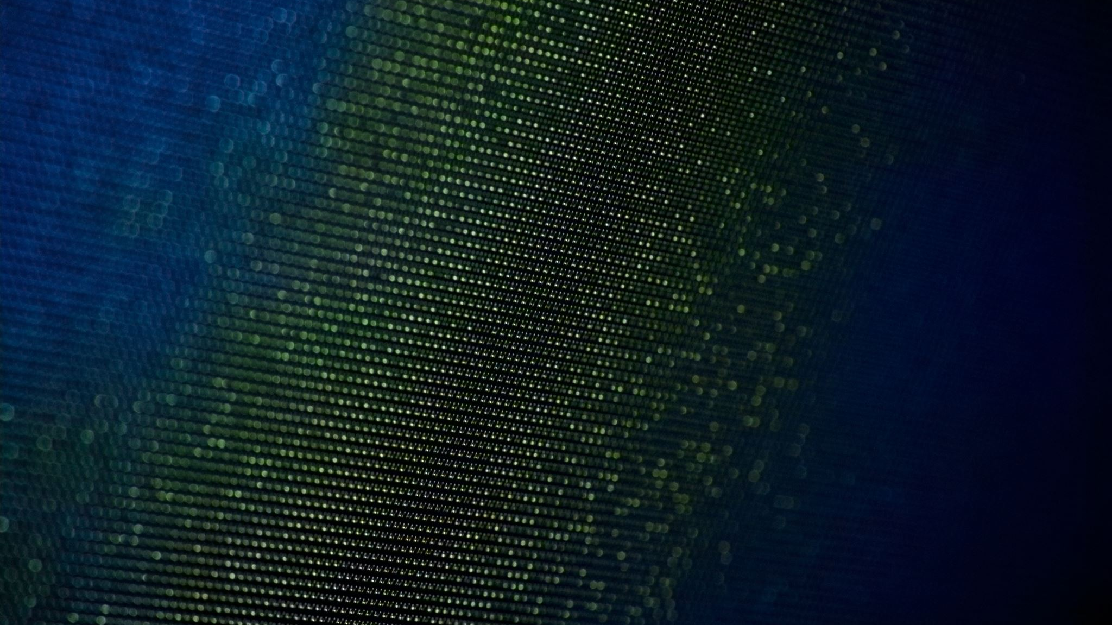
DESIGN PROCESS
1
2
3
4
5
Empathize: Immersing ourselves in the user's perspective through research and observation to understand their needs, pain points, and behaviors.
Define: Synthesizing research findings to define clear design goals and problem statements, ensuring alignment with user needs and business objectives.
Ideate: Brainstorming creative solutions through collaborative ideation sessions, exploring diverse concepts and possibilities to address identified challenges.
Deliver: Executing the chosen design solutions with precision and attention to detail, leveraging tools like Figma to create high-fidelity prototypes and design mockups.
Test: Iteratively testing prototypes with real users to gather feedback, validate design decisions, and refine the user experience based on insights gathered from usability testing sessions.

Slide 7




TARGET AUDIENCE
Tech-savvy Fashionistas: Individuals who blend their love for fashion with a penchant for technology, seeking both trendy apparel and cutting-edge electronic accessories to complement their lifestyle.
Young Professionals: Busy urbanites aged between 18 to 35, juggling work and social life, looking for a one-stop destination offering not only fashionable clothing but also reliable electronic gadgets like smartphones and PCs.
Style-Conscious Gamers: Fashion-forward gamers who prioritize both style and functionality in their accessories, requiring trendy clothing and high-performance electronic gadgets for gaming and everyday use.
Modern Trendsetters: Trend-conscious individuals who strive to stay ahead of the curve, seeking the latest fashion trends as well as state-of-the-art electronic accessories to showcase their sense of style and technological savvy.

Slide 8

WHY USER RESEARCH?
Persona:
SWOT Analysis:
Competitive Analysis:
User Journey Map:
Reason for Use: Personas were utilized to create fictional characters representing different user segments, enabling us to empathize with and understand the diverse needs and preferences of our target audience.
Reason for Use:
SWOT analysis was conducted to assess Myntra's internal strengths and weaknesses, as well as external opportunities and threats in the competitive landscape.
Reason for Use: Competitive analysis was conducted to evaluate Myntra's strengths and weaknesses relative to its competitors in the fashion and tech e-commerce space.
Reason for Use:
User journey mapping was employed to visualize and understand the end-to-end experience of users interacting with the Myntra platform.

Slide 9

PERSONA 1 Fashionable Tech Enthusiast
Background:
Sophia is a 25-year-old fashion blogger and technology enthusiast. She loves staying up-to-date with the latest fashion trends and tech gadgets, often incorporating them into her lifestyle and content creation.
Frustrations:
Complexity: Sophia finds it overwhelming to navigate through multiple platforms to shop for both fashion clothing and electronic accessories.
Limited Options: She often struggles to find platforms that offer a diverse range of trendy fashion items and high-quality tech products in one place.
Goals:
Convenience: Sophia seeks a seamless shopping experience where she can easily find both fashionable clothing and trendy electronic accessories.
Quality: She wants access to a curated selection of authentic and reliable products, ensuring that she gets the best value for her money.
Expression: Sophia aims to express her unique style and personality through her fashion choices and tech accessories, looking for platforms that offer a wide variety of options to suit her preferences.

Slide 10

PERSONA 2 Busy Professional on the Go
Background:
Alex is a 30-year-old marketing manager working in a fast-paced corporate environment. He values efficiency and reliability in all aspects of his life, including his shopping experiences.
Frustrations:
Time Constraints: Alex often struggles to find time for shopping amidst his hectic work schedule and personal commitments.
Overwhelm: He feels overwhelmed by the abundance of options available online and worries about making the right choices, especially when it comes to tech gadgets.
Goals:
Convenience: Alex seeks a hassle-free shopping experience where he can quickly find everything he needs, from professional attire to reliable electronic gadgets.
Quality: He wants access to high-quality products from trusted brands, ensuring that his purchases meet his standards of durability and performance.
Confidence: Alex aims to shop with confidence, knowing that he can rely on the platform to deliver authentic products and excellent customer service.

Slide 11
SWOT ANALYSIS
Strengths:
Weaknesses:
Opportunities:
Threats:
Strong brand recognition and reputation in the fashion industry.
Wide range of products, including both fashion clothing and electronic accessories.
User-friendly interface and seamless shopping experience.
Potential for improvement in customer service and post-purchase support.
Limited customization options for electronic accessories compared to specialized tech platforms.
Competition from both fashion retailers and dedicated electronic gadget stores.
Expansion into new markets or product categories to diversify offerings.
Collaborations with tech brands to offer exclusive electronic accessories.
Leveraging data analytics to personalize recommendations and enhance user experience.
Intense competition from other e-commerce giants and niche tech retailers.
Rapid changes in fashion trends and technology advancements.
Economic downturns or shifts in consumer spending habits impacting purchasing power.

Slide 12
COMPETITVE ANALYSIS
Aspect | Myntra | Amazon Fashion | Flipkart | Dedicated Tech Retailers
Product Range | Fashion clothing, electronic accessories | Fashion clothing, electronic gadgets | Fashion clothing, limited electronic accessories | Electronic gadgets
Brand Reputation | Strong | Strong | Strong | Varies
User Experience | User-friendly interface | Smooth navigation | Intuitive interface | Specialized expertise
Customer Service | Moderate | Reliable | Responsive | Specialized support
Pricing | Competitive | Competitive | Competitive | Varies
Delivery Options | Standard and express options | Fast delivery | Fast delivery | Varies
Unique Features | Fashion collaborations, curated collections | Wide range of products, Prime benefits | Sales events, discounts | Expert advice, in-store experiences
Market Presence | Dominant in fashion segment | E-commerce giant | Established player | Niche market

Slide 13
USER JOURNEY MAP
Awareness and Discovery:
Sign-up and Onboarding:
Exploration of Fashion and Tech Categories:
Adding to Cart and Checkout:
Delivery and Product Satisfaction:
Feedback and Engagement:
Scenario: User learns about Myntra's fashion clothing and electronic accessories through social media or recommendations from friends.
Scenario: User decides to create an account on Myntra to start shopping.
User: Emma begins exploring Myntra's fashion clothing and electronic accessories categories.
Scenario: Emma finds items she likes and decides to make a purchase.
Scenario: Emma eagerly awaits the delivery of her order.
Scenario: Emma continues to engage with Myntra's platform.
Action: User visits the Myntra website or downloads the mobile app to explore its offerings.
Action: User completes the registration process, providing her details and verifying her email address.
Action: User navigates through the platform, browsing curated collections, and filtering products based on her preferences.
Action: Emma adds her chosen fashion clothing and electronic accessories to the cart and proceeds to checkout.
Action: Emma receives her products and evaluates their quality and fit.
Action: Emma provides feedback and suggestions for improvement through user surveys or feedback forms.
Outcome: User gains a basic understanding of Myntra's product range and capabilities, sparking her interest in the platform.
Outcome: User account is successfully created, and she receives personalized recommendations based on her preferences, enhancing her shopping experience.
Outcome: User discovers a wide variety of trendy fashion items and high-quality tech gadgets, finding items that match her style and needs.
Outcome: Emma completes the purchase process securely, with multiple payment options available, and receives a confirmation of her order.
Outcome: Emma is satisfied with her purchases, enjoying the stylish fashion items and functional tech gadgets that enhance her daily life.
Outcome: Myntra uses Emma's feedback to enhance its platform, ensuring a better shopping experience for all users.

Slide 14
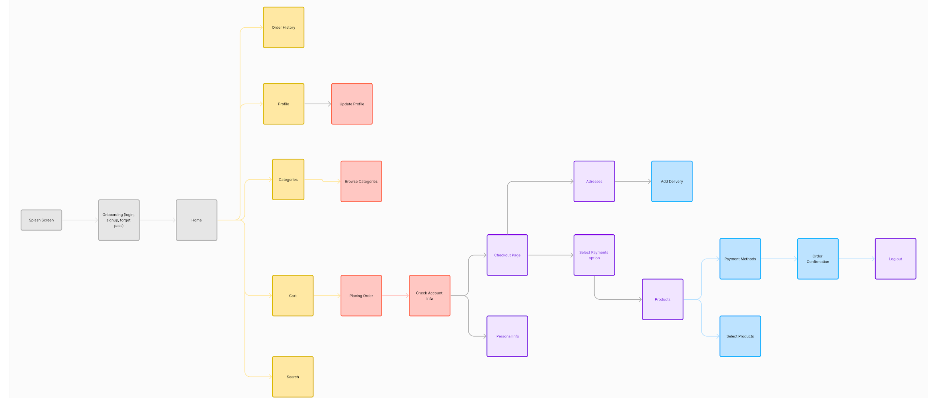
INFORMATION ARCHITECTURE DIAGRAM

Slide 15
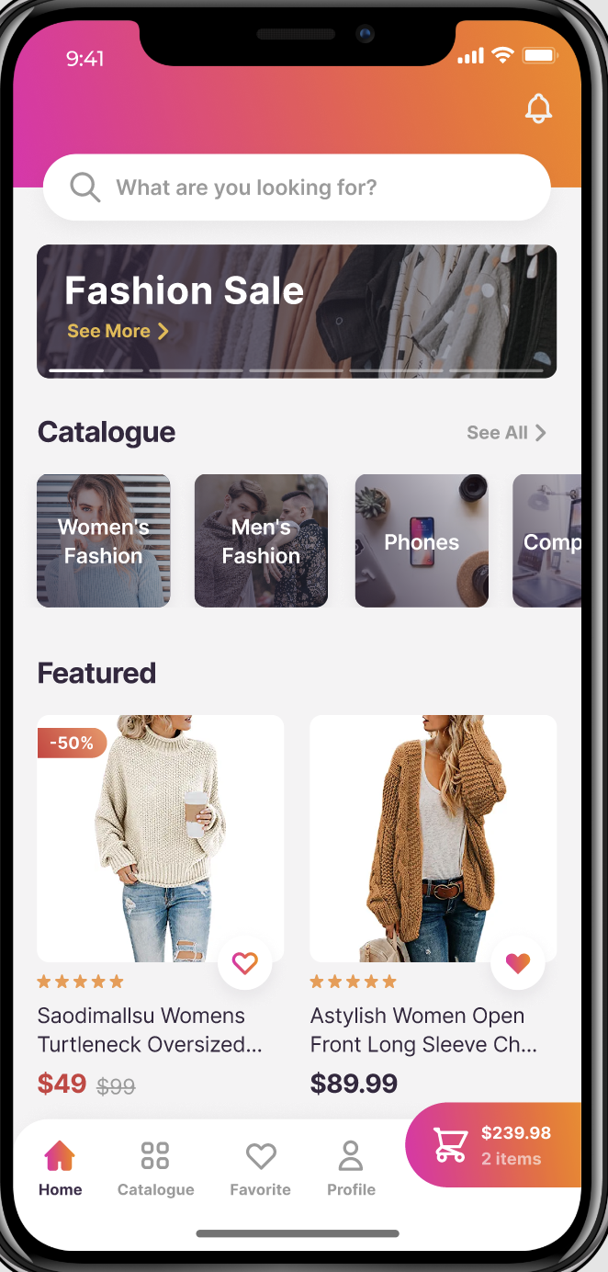
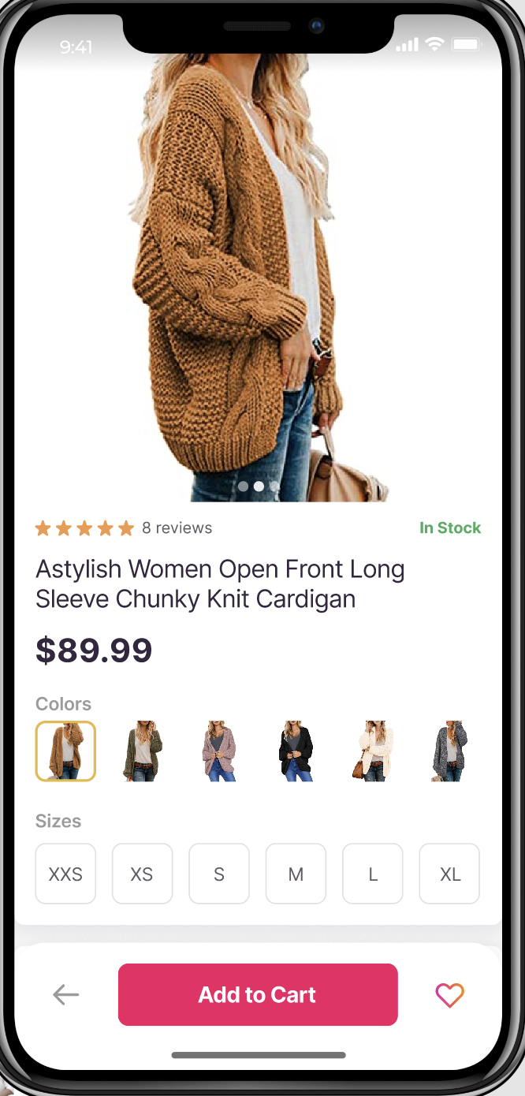
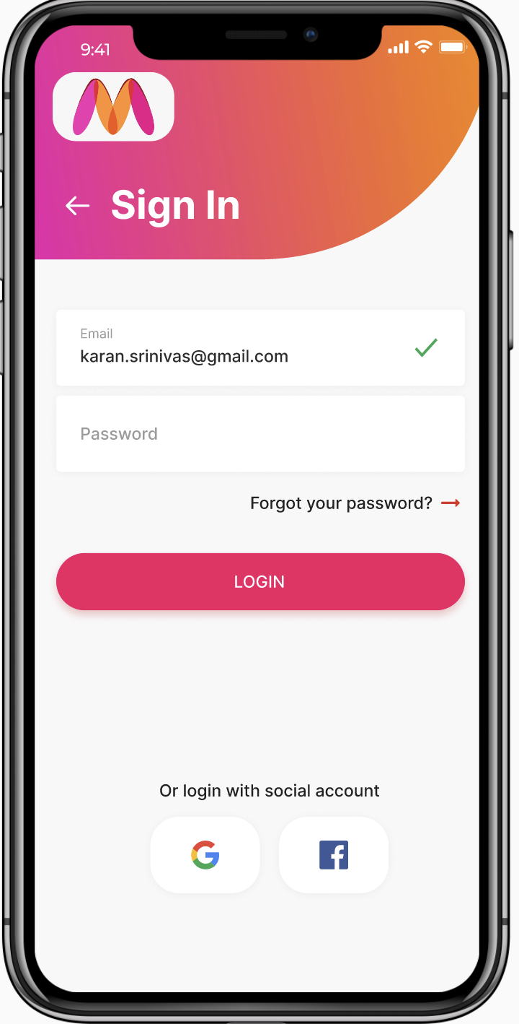
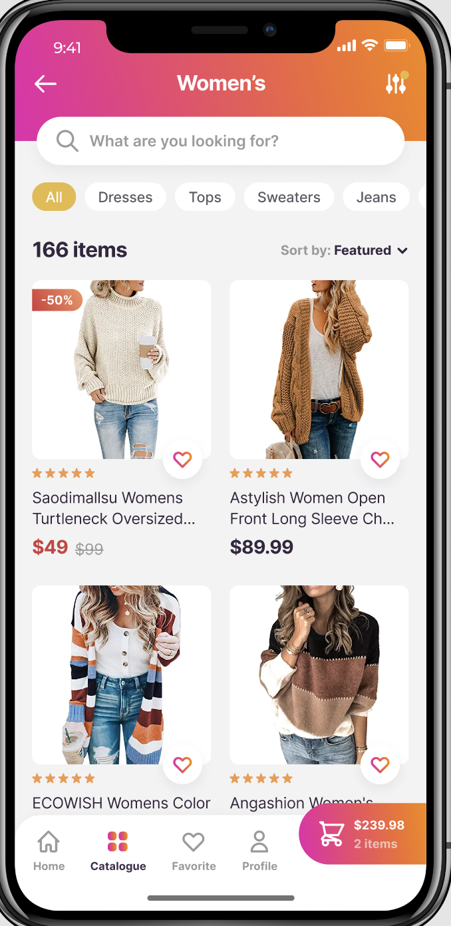
FIGMA WIREFRAME SCREENS

Slide 16
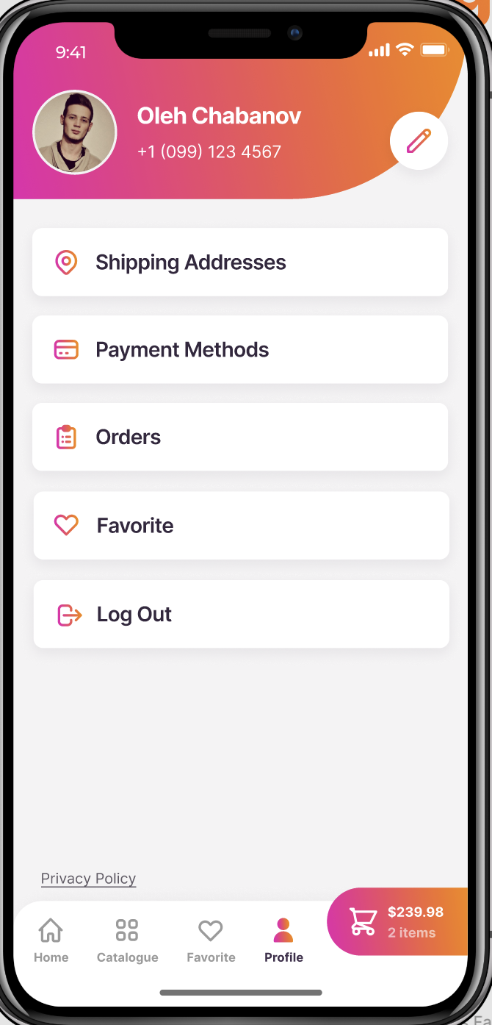
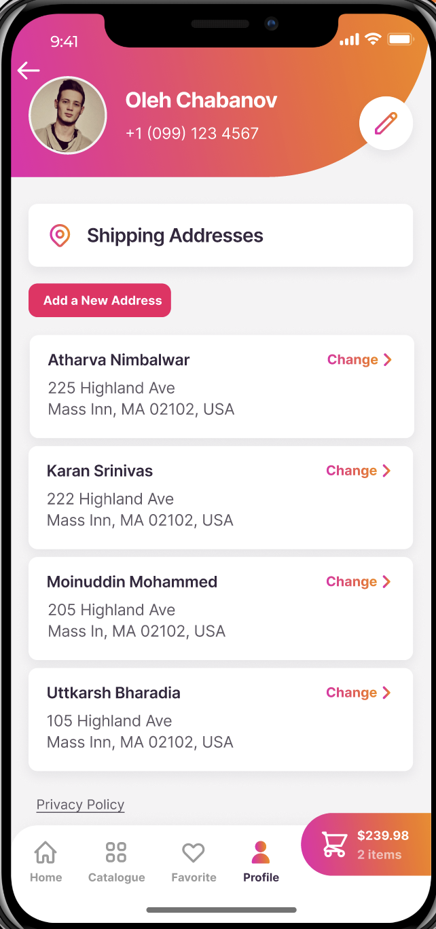
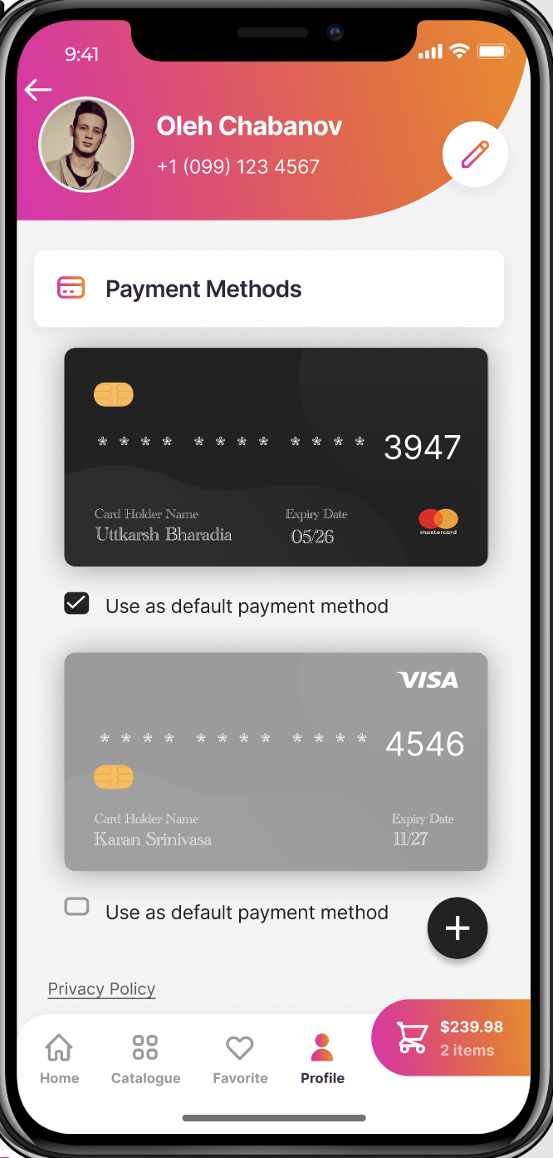
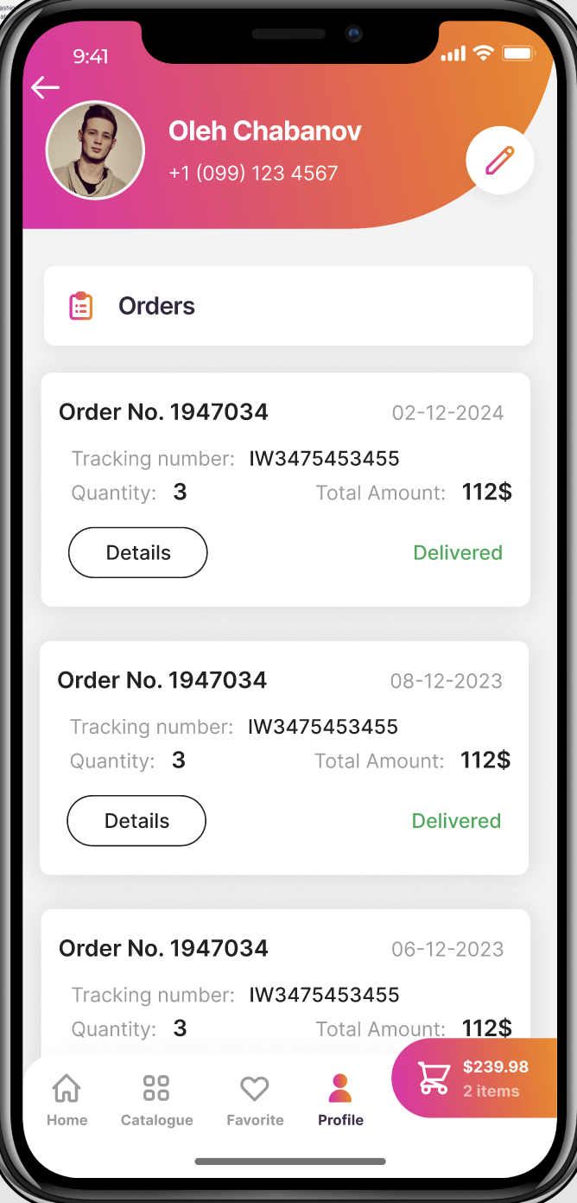
FIGMA WIREFRAME SCREENS

Slide 17
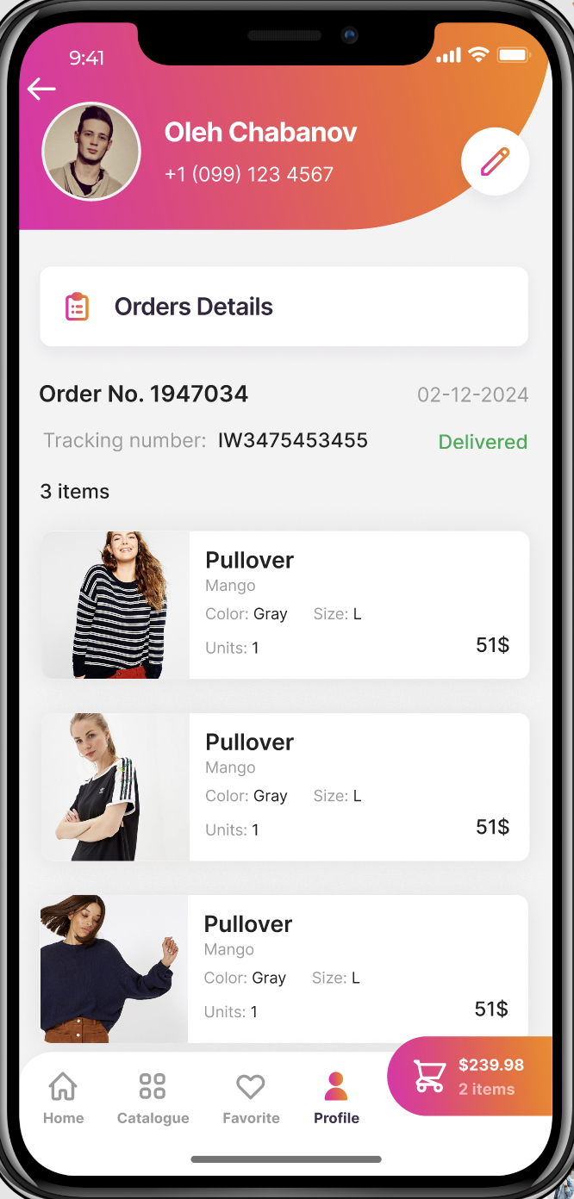
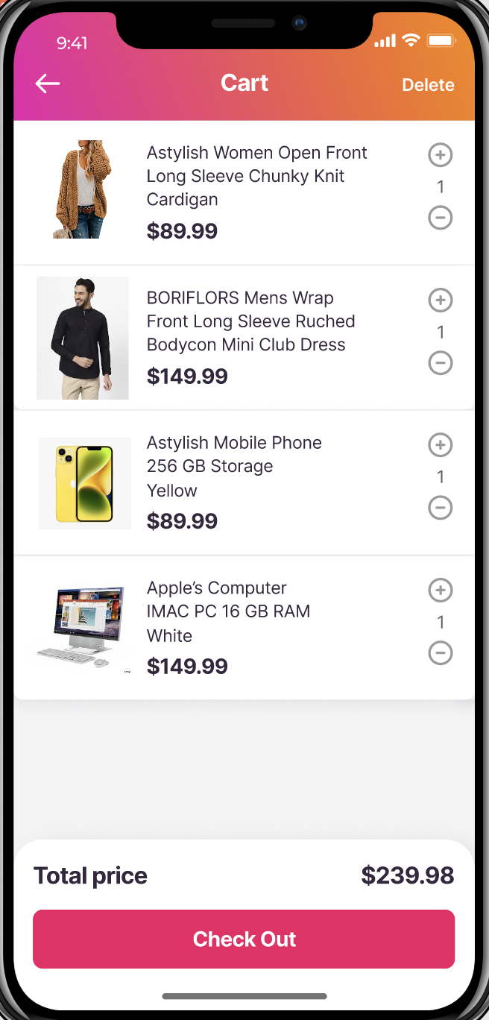
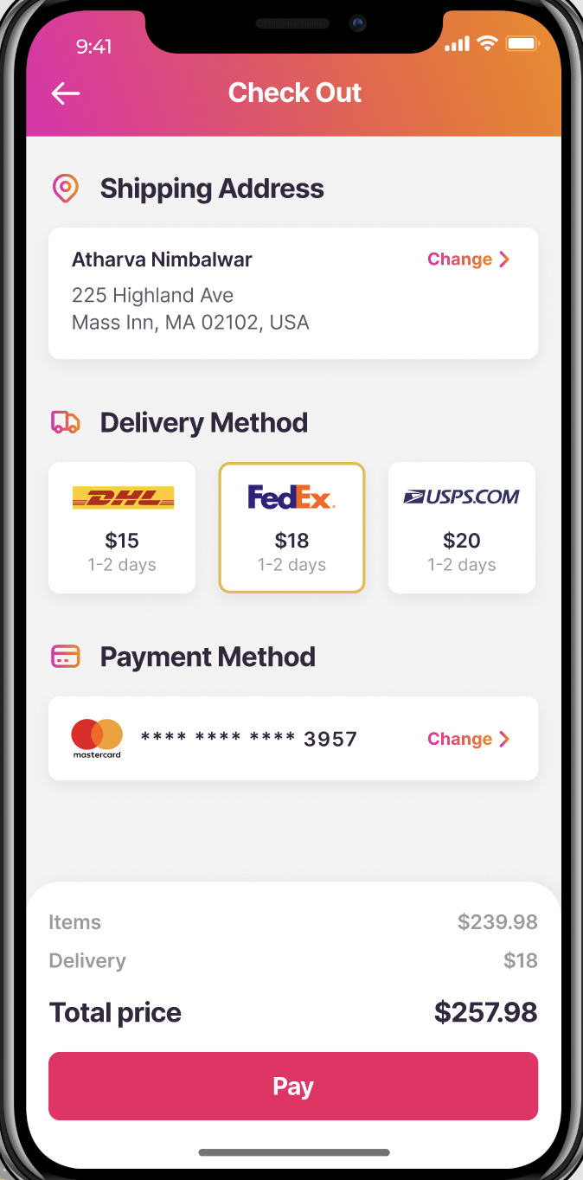
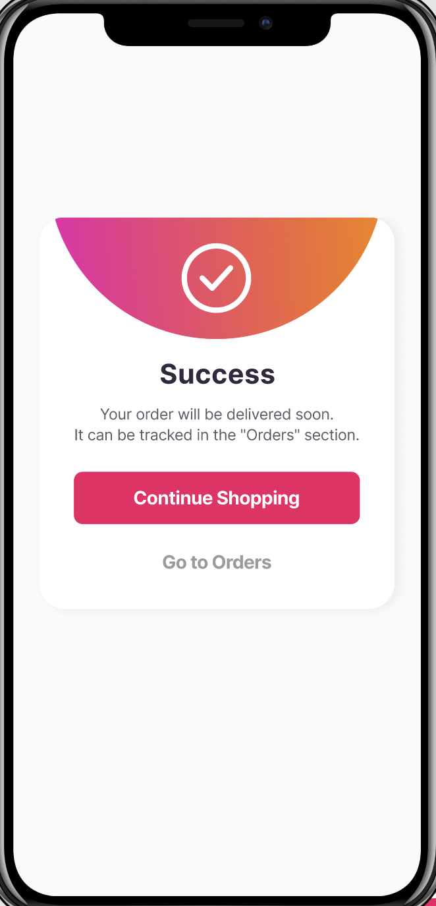
FIGMA WIREFRAME SCREENS

Slide 18
APPLICATIONS OF DESIGN PLANES
Strategy Plane:
Scope Plane:
Structure Plane:
Skeleton Plane:
Surface Plane:
Application: Formulated a strategic approach to the redesign project, aligning with Myntra's business goals and target market.
Outcome: Defined the project's objectives, including enhancing user engagement, increasing conversion rates, and expanding product offerings to include electronic accessories.
Application: Defined project requirements and prioritized features using the MoSCoW technique.
Outcome: Identified essential features such as intuitive navigation, seamless checkout process, and personalized recommendations to enhance user experience.
Application: Organized content and information architecture to ensure logical flow and easy navigation.
Outcome: Implemented a clear categorization of fashion clothing and electronic accessories, improving discoverability and reducing user friction.
Application: Created wireframes and prototypes to visualize the layout and interactions of the redesigned platform.
Outcome: Refined interface elements such as buttons, menus, and forms to optimize usability and user engagement.
Application: Developed a cohesive design system, including colors, typography, and imagery, to create a visually appealing interface.
Outcome: Enhanced brand identity and user engagement through consistent and aesthetically pleasing visuals, reinforcing Myntra's position as a leading fashion and tech destination.

Slide 19
MoSCoW APPROACH
Must-Have:
Intuitive Navigation: Prioritized to ensure users can easily browse and find products.
Seamless Checkout Process: Given high priority to enhance user experience and encourage conversions.
Responsive Design: Essential for ensuring the platform is accessible and user-friendly across devices.
Should-Have:
Personalized Recommendations: Considered important for enhancing user engagement and driving repeat visits.
Enhanced Search Functionality: Deemed valuable for facilitating product discovery and improving user satisfaction.
Could-Have:
Social Media Integration: Considered as an additional feature to enhance user interaction and sharing.
Advanced Filtering Options: Viewed as a potential enhancement to provide users with more control over their shopping experience.
Won't-Have :
Augmented Reality Try-On: Deemed as a feature for future consideration due to resource constraints and complexity.
Loyalty Program Integration: Not prioritized for the current phase but may be revisited in future iterations.

Slide 20




CONCLUSION
Project Success: The Myntra redesign project has been a success, resulting in a more user-friendly and visually appealing platform.
Enhanced User Experience: By prioritizing user needs and implementing design best practices, we have significantly improved the shopping experience for our users.
Future Growth: Moving forward, we aim to continue iterating and refining the platform to further enhance user satisfaction and drive business growth.

Slide 21

FUTURE SCOPE
Expansion into New Markets: Explore opportunities to expand Myntra's reach by offering localized versions tailored to specific regions or demographics.
Integration of Emerging Technologies: Investigate the integration of technologies such as AI and AR to provide innovative shopping experiences, such as virtual try-on features.
Enhancement of Personalization: Further personalize user experiences by leveraging data analytics and machine learning algorithms to offer tailored recommendations and promotions.

Slide 22






REFERENCES
Nielsen Norman Group: A leading authority on UX research and design, providing valuable insights and best practices for creating user-friendly interfaces. (Reference link: www.nngroup.com)
Google Material Design: A comprehensive guide for designing digital interfaces, offering principles, guidelines, and resources for creating visually appealing and functional designs. (Reference link: material.io)
Interaction Design Foundation: An online resource offering courses, articles, and books on various aspects of interaction design and user experience. (Reference link: www.interaction-design.org)
Smashing Magazine: A popular web design and development publication, featuring articles, tutorials, and case studies on UX/UI design, front-end development, and web standards. (Reference link: www.smashingmagazine.com)
Myntra Blog: Insights and updates from Myntra's own blog, providing information on fashion trends, product launches, and user engagement strategies. (Reference link: blog.myntra.com)

Slide 23
DEMONSTRATION OF REDESIGN
Figma Prototype Link
https://www.figma.com/file/6jCA6R9FJL98lvCSAX07yS/Myntra?type=design&node-id=0-1&mode=design&t=1VE7gRXi5evK7sCy-0\

Slide 24


